Slide 1


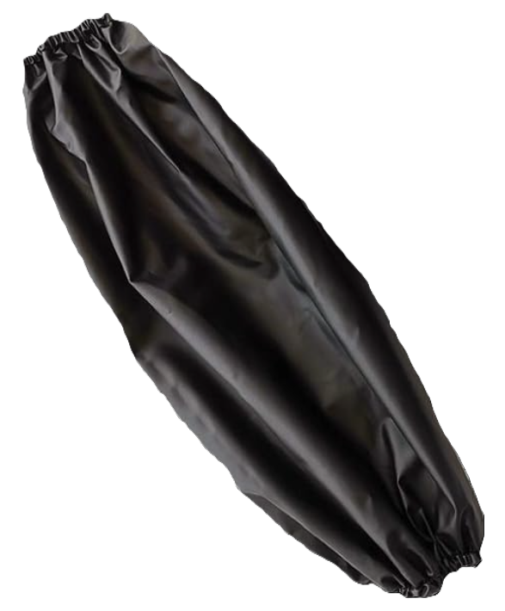
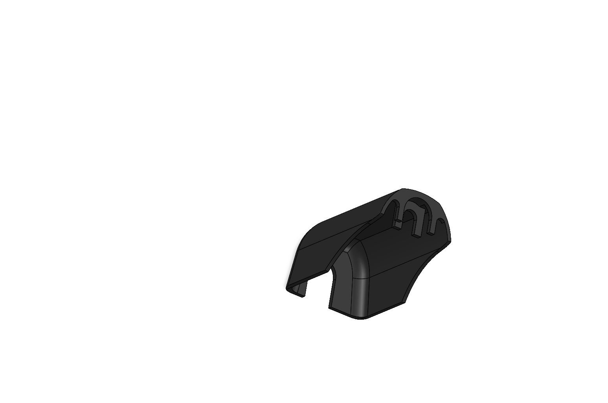
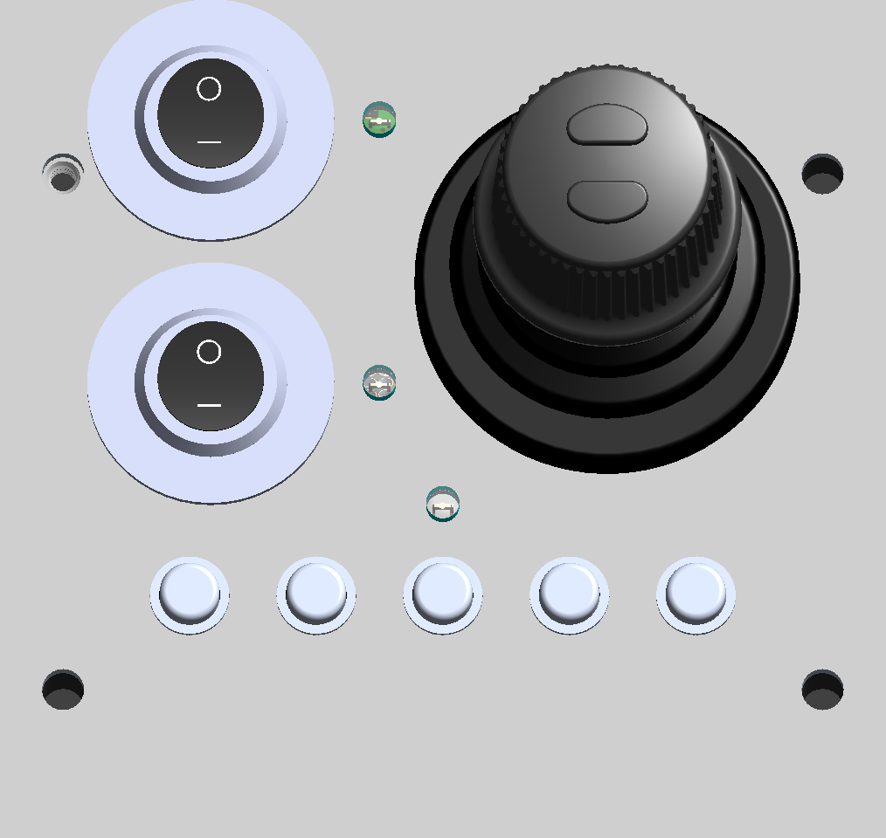
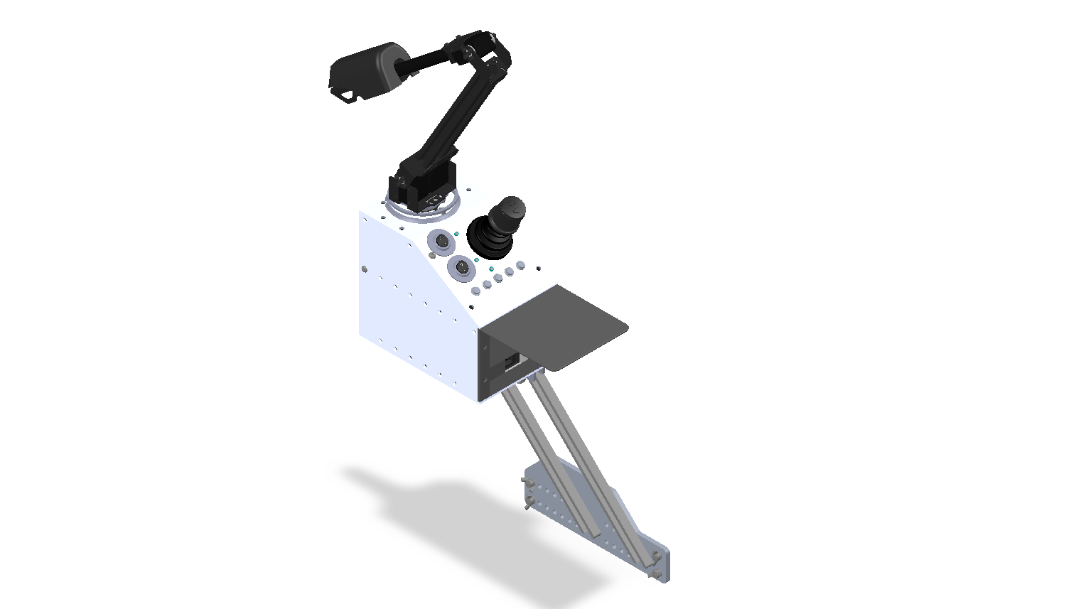

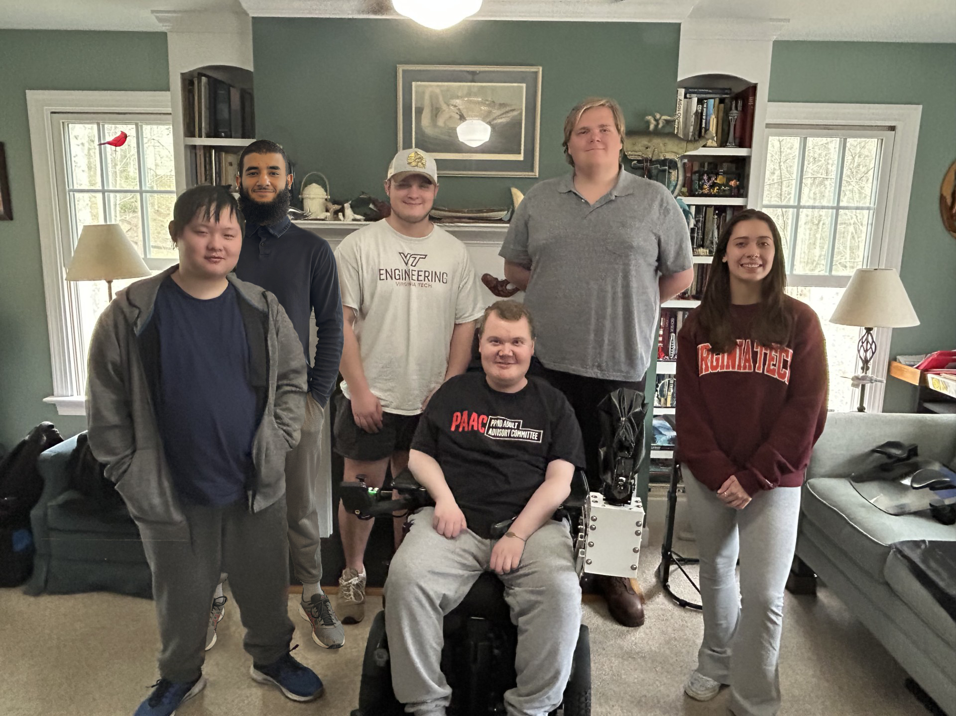
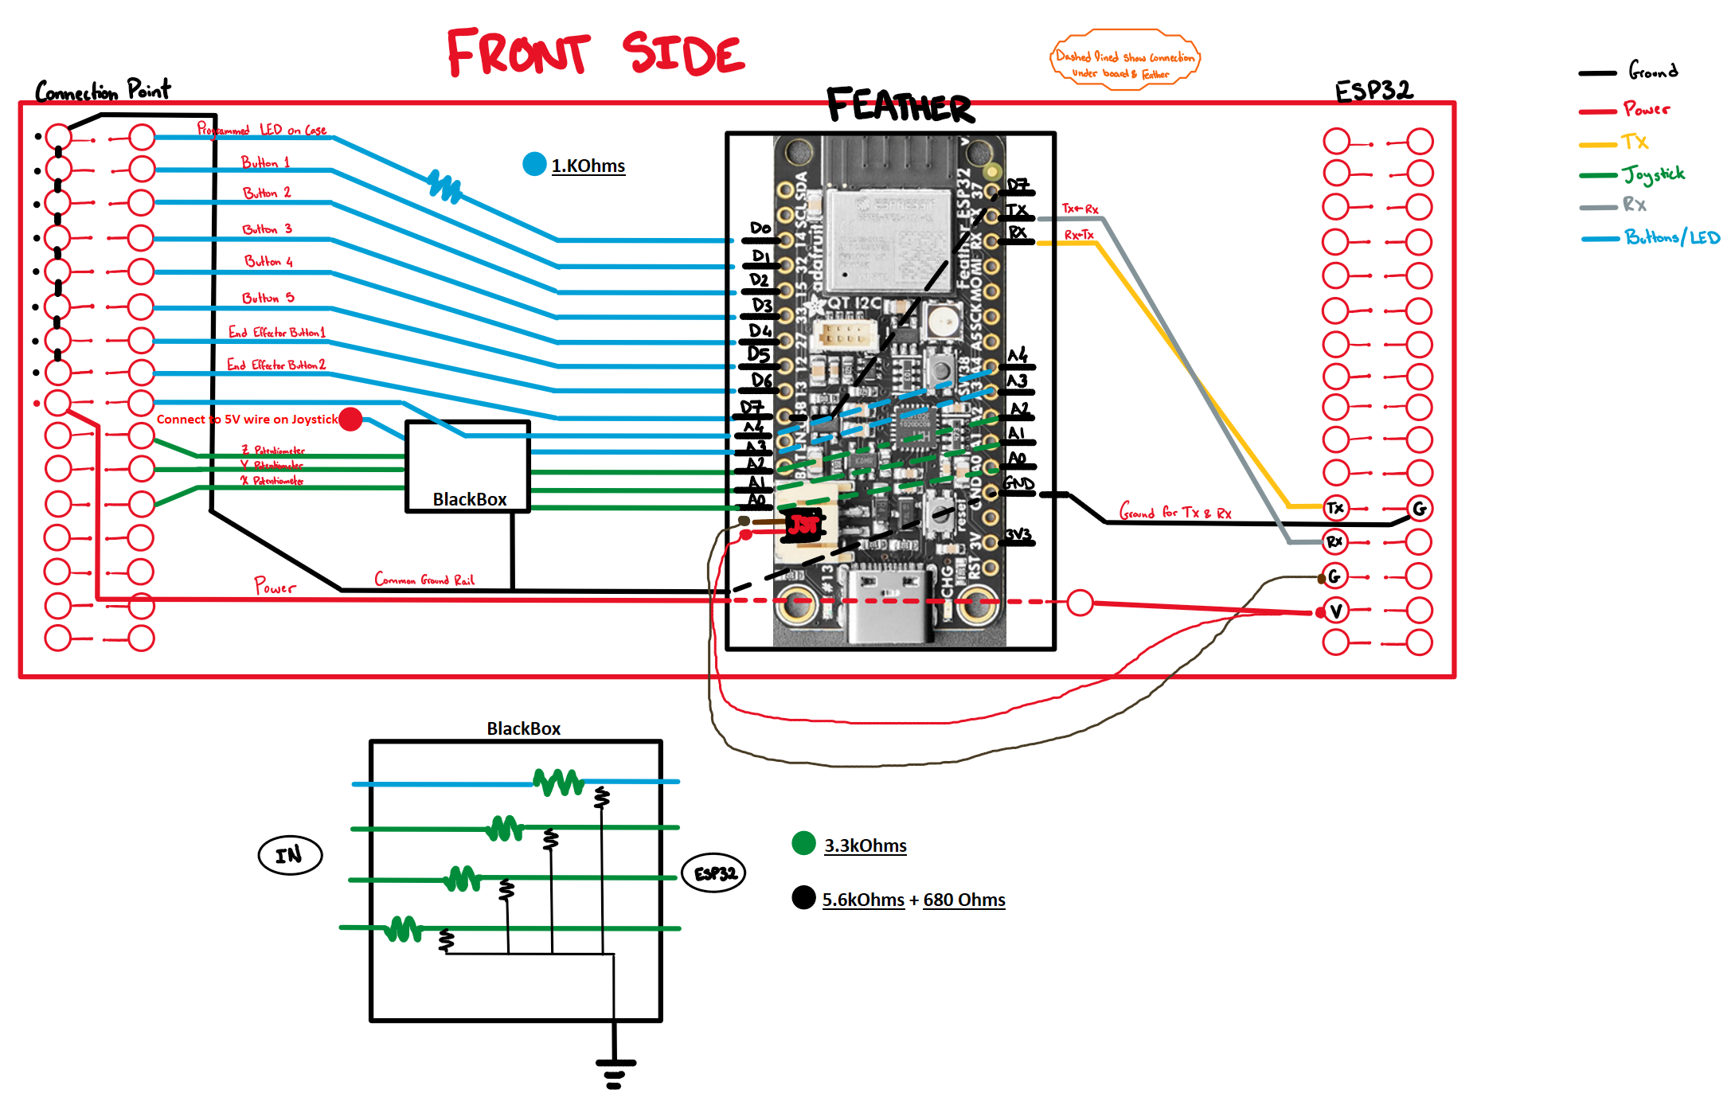
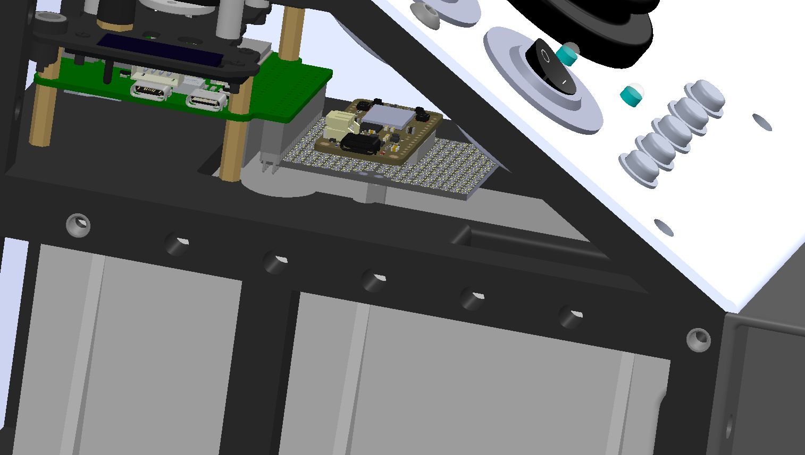
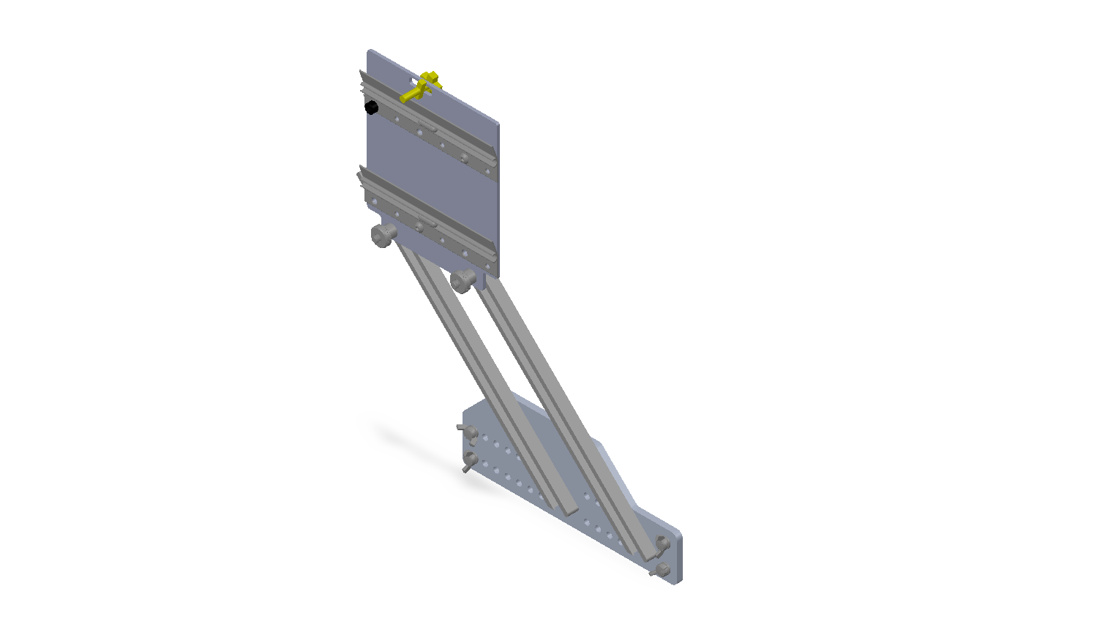
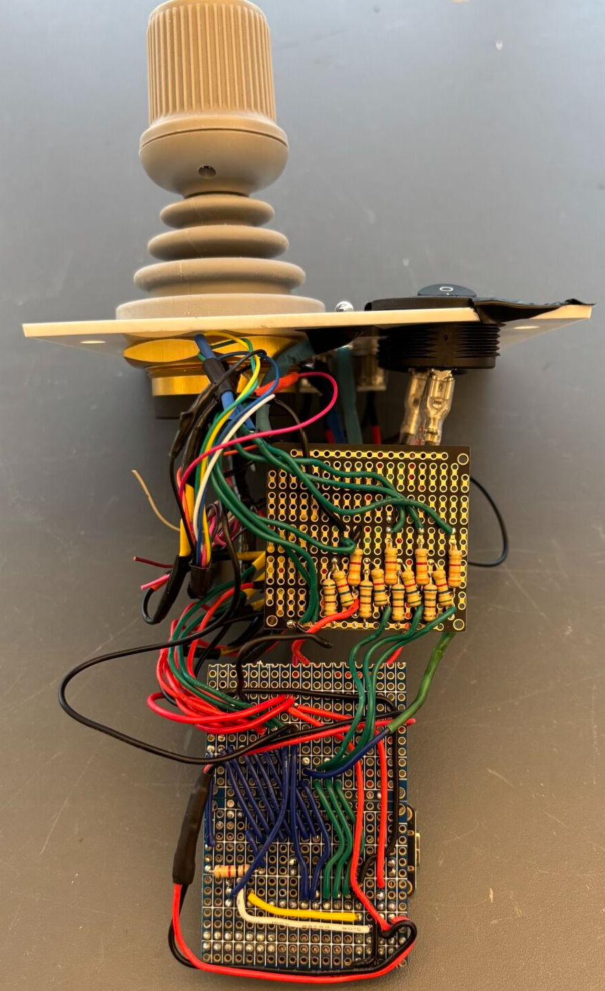
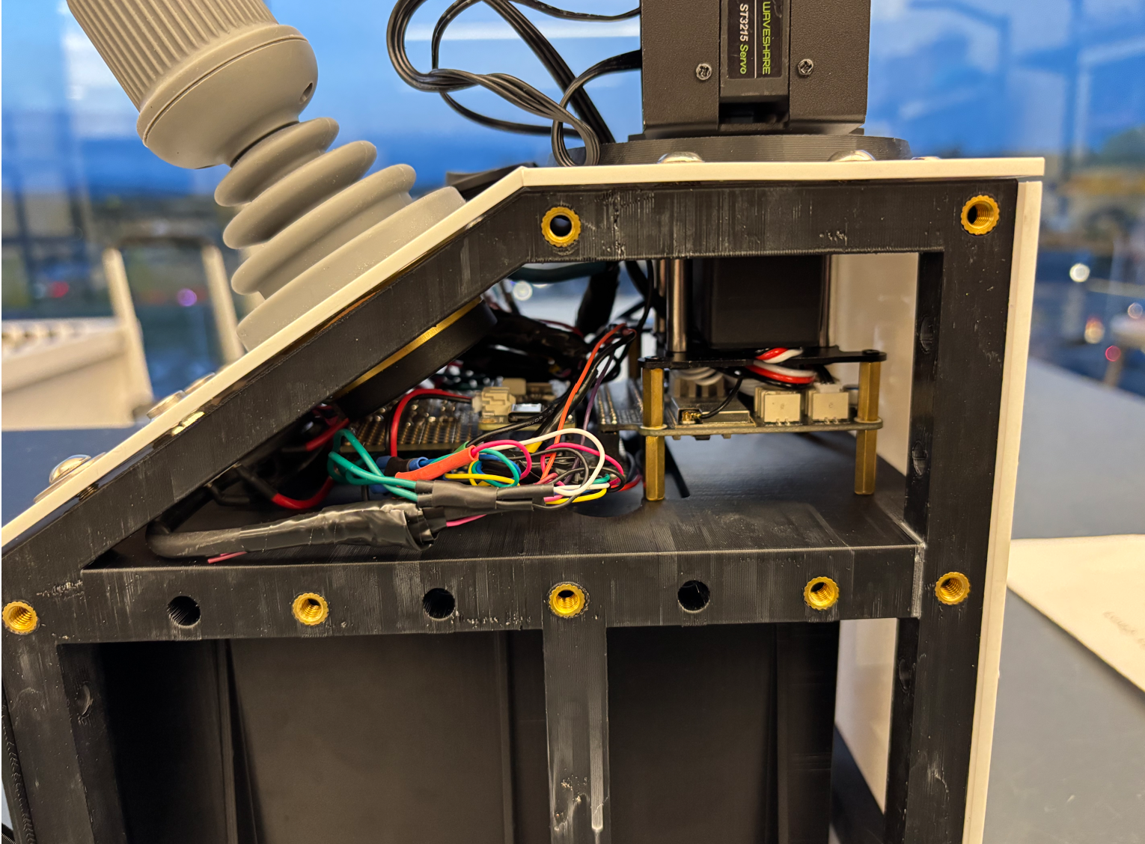
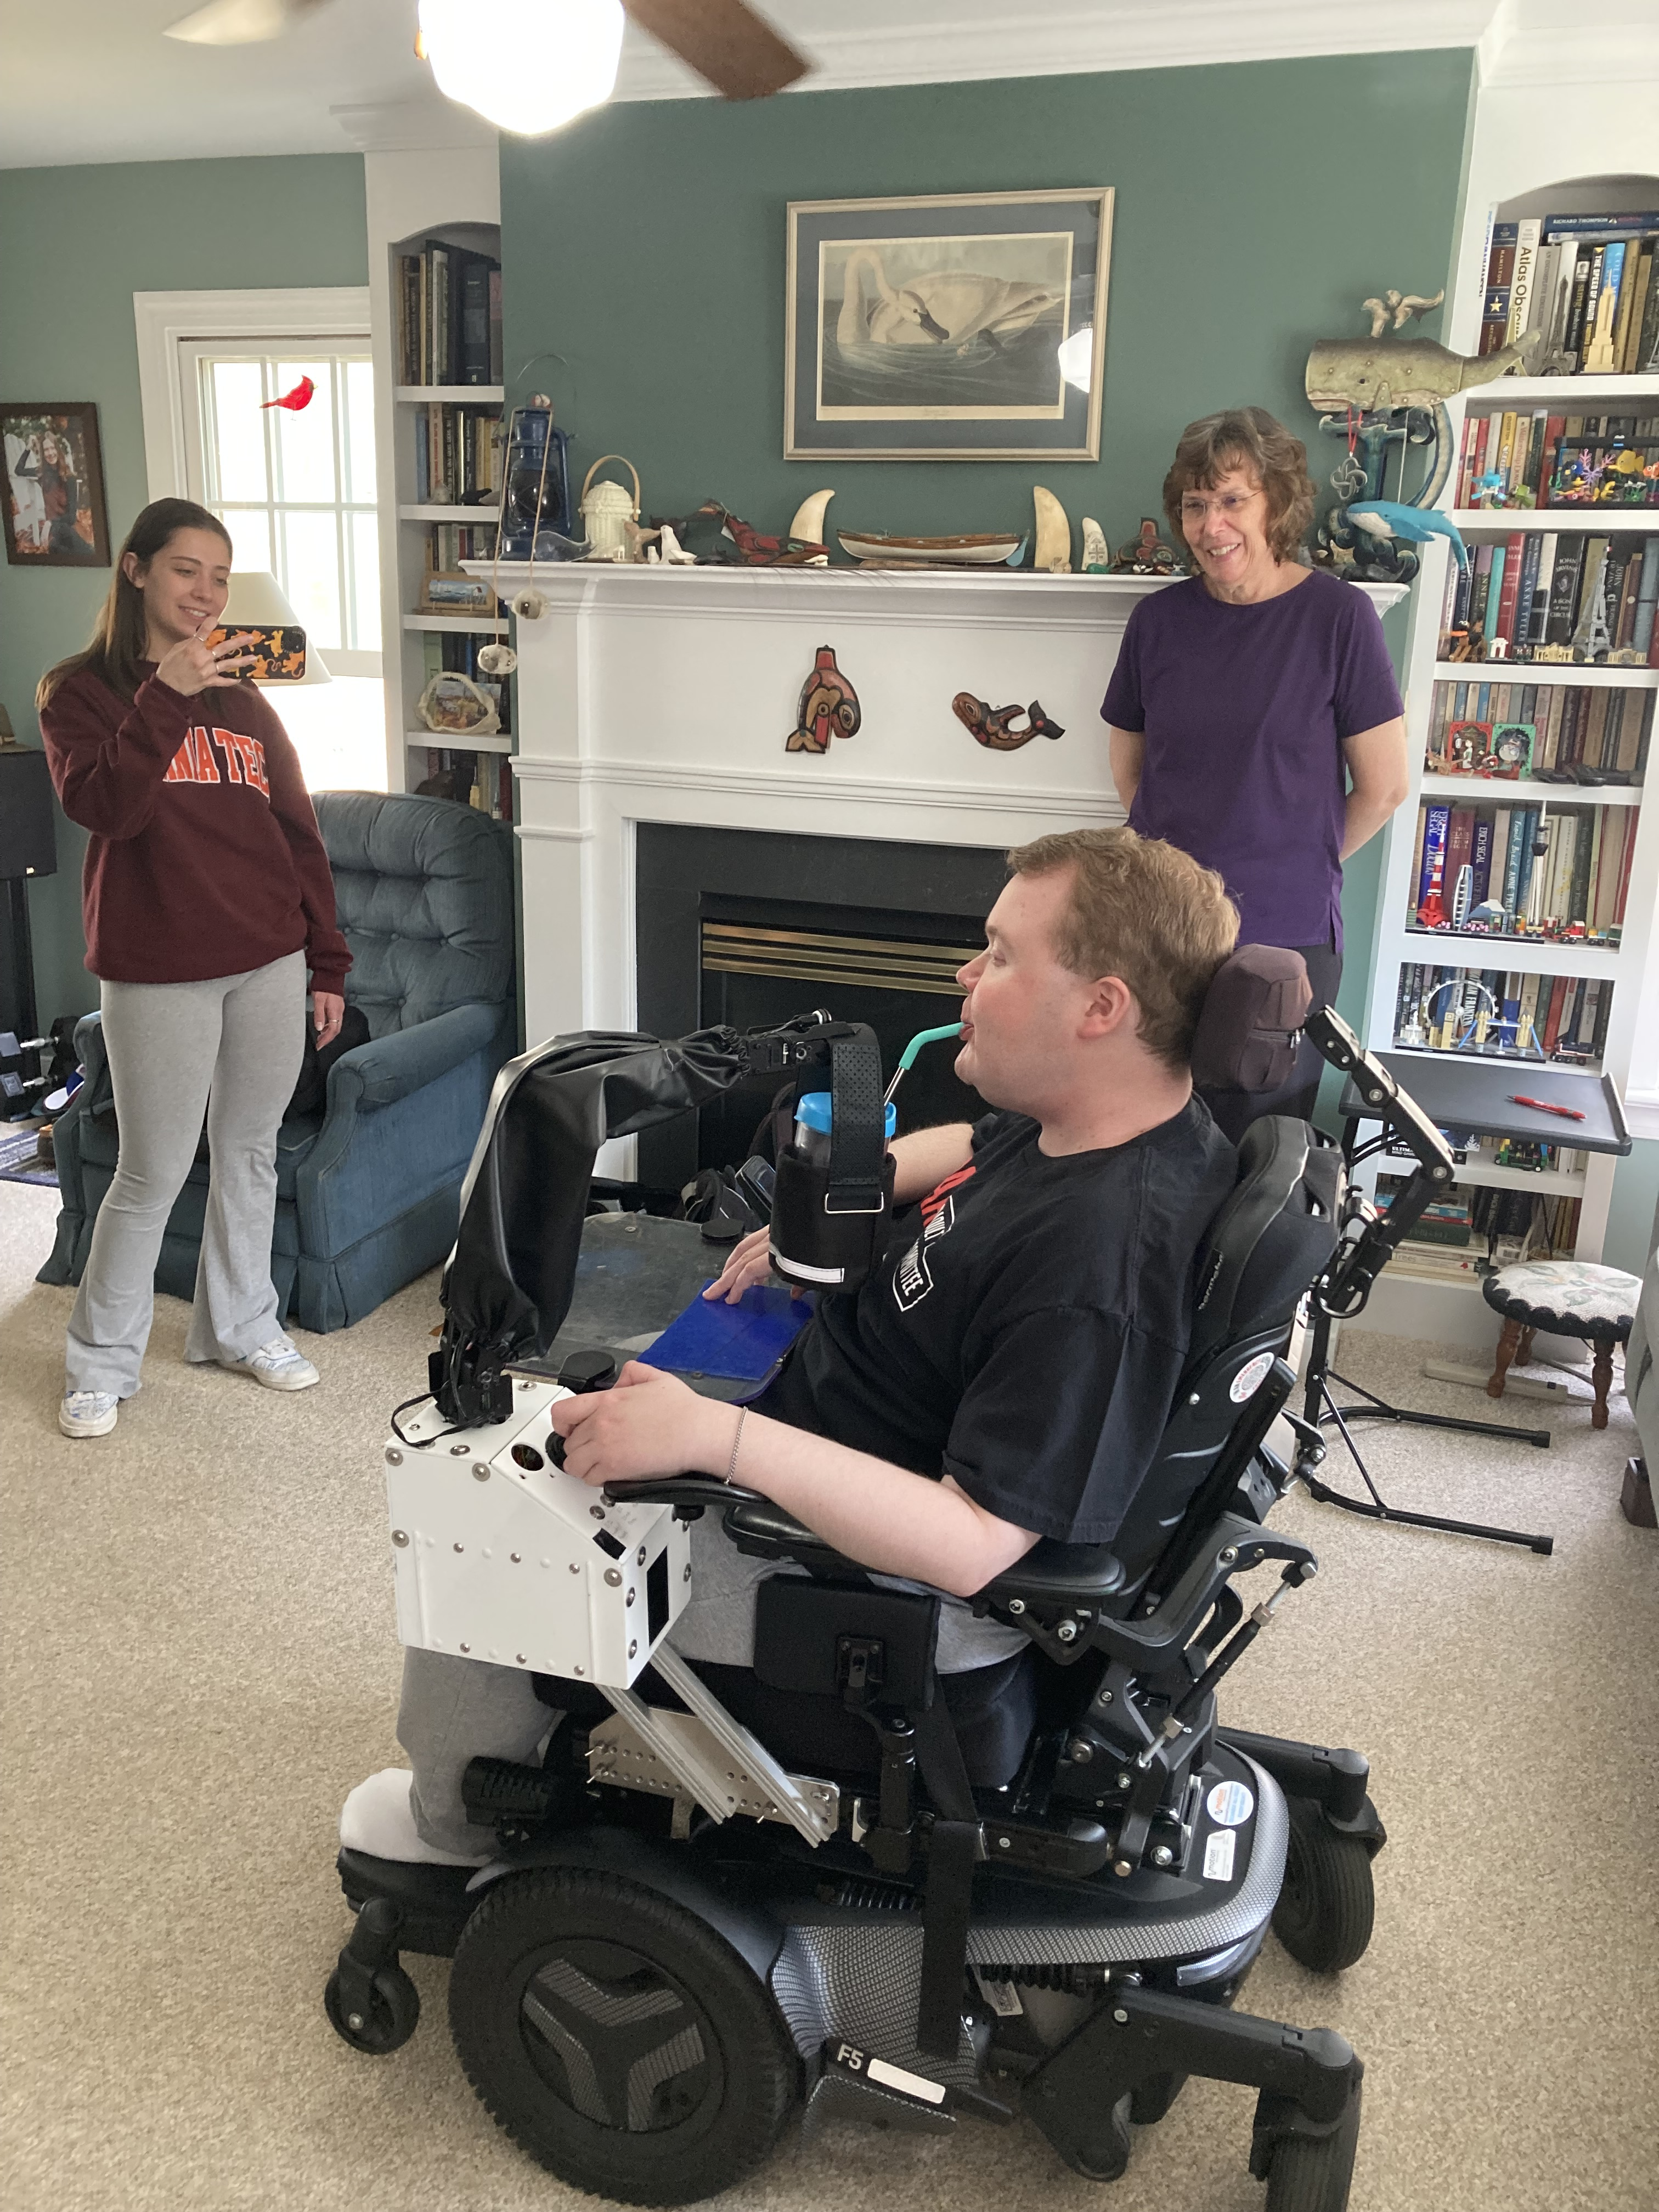
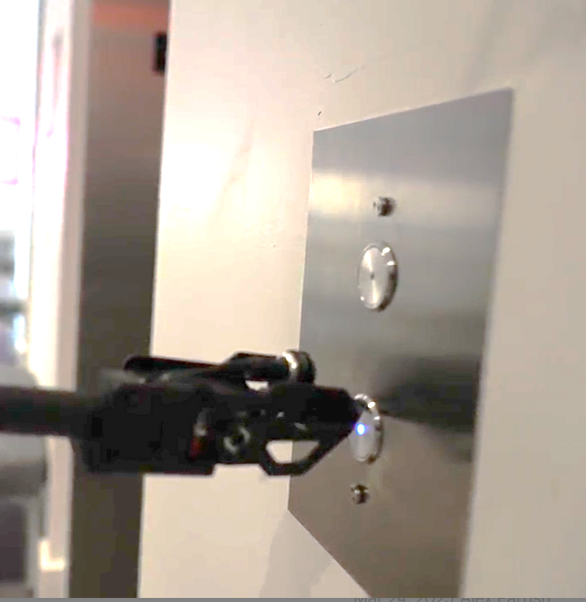
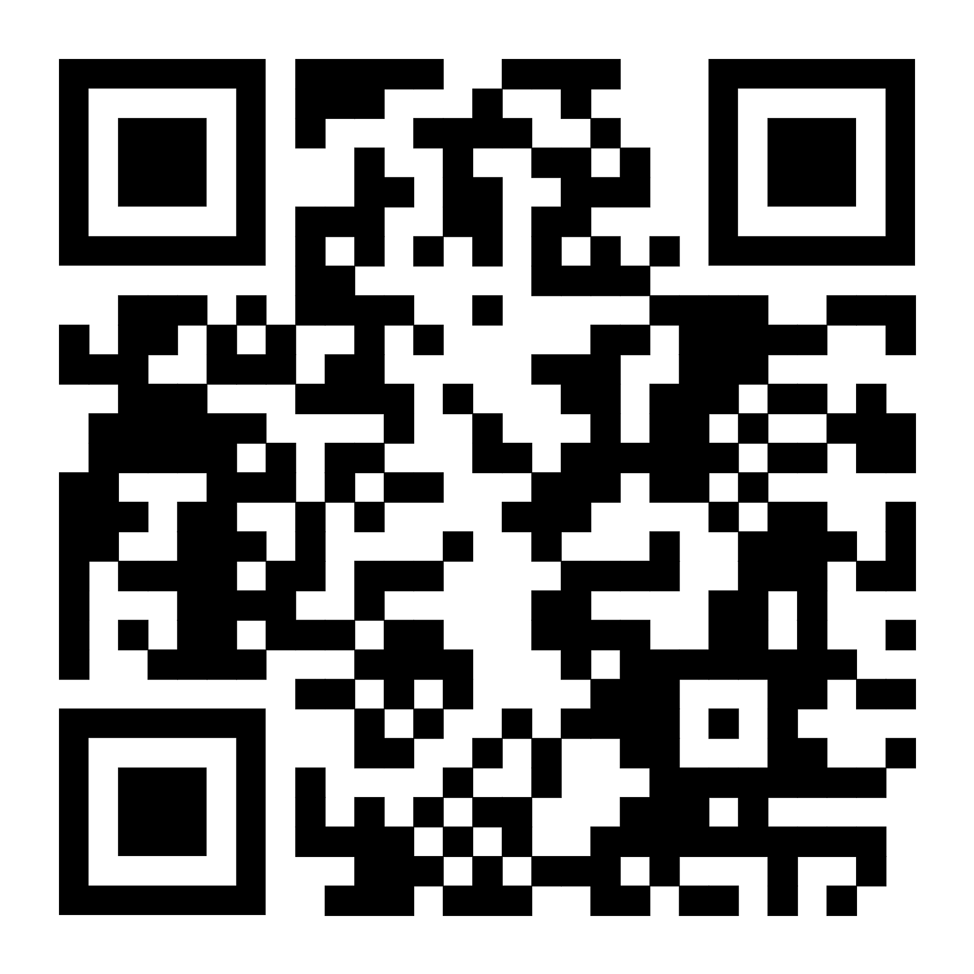
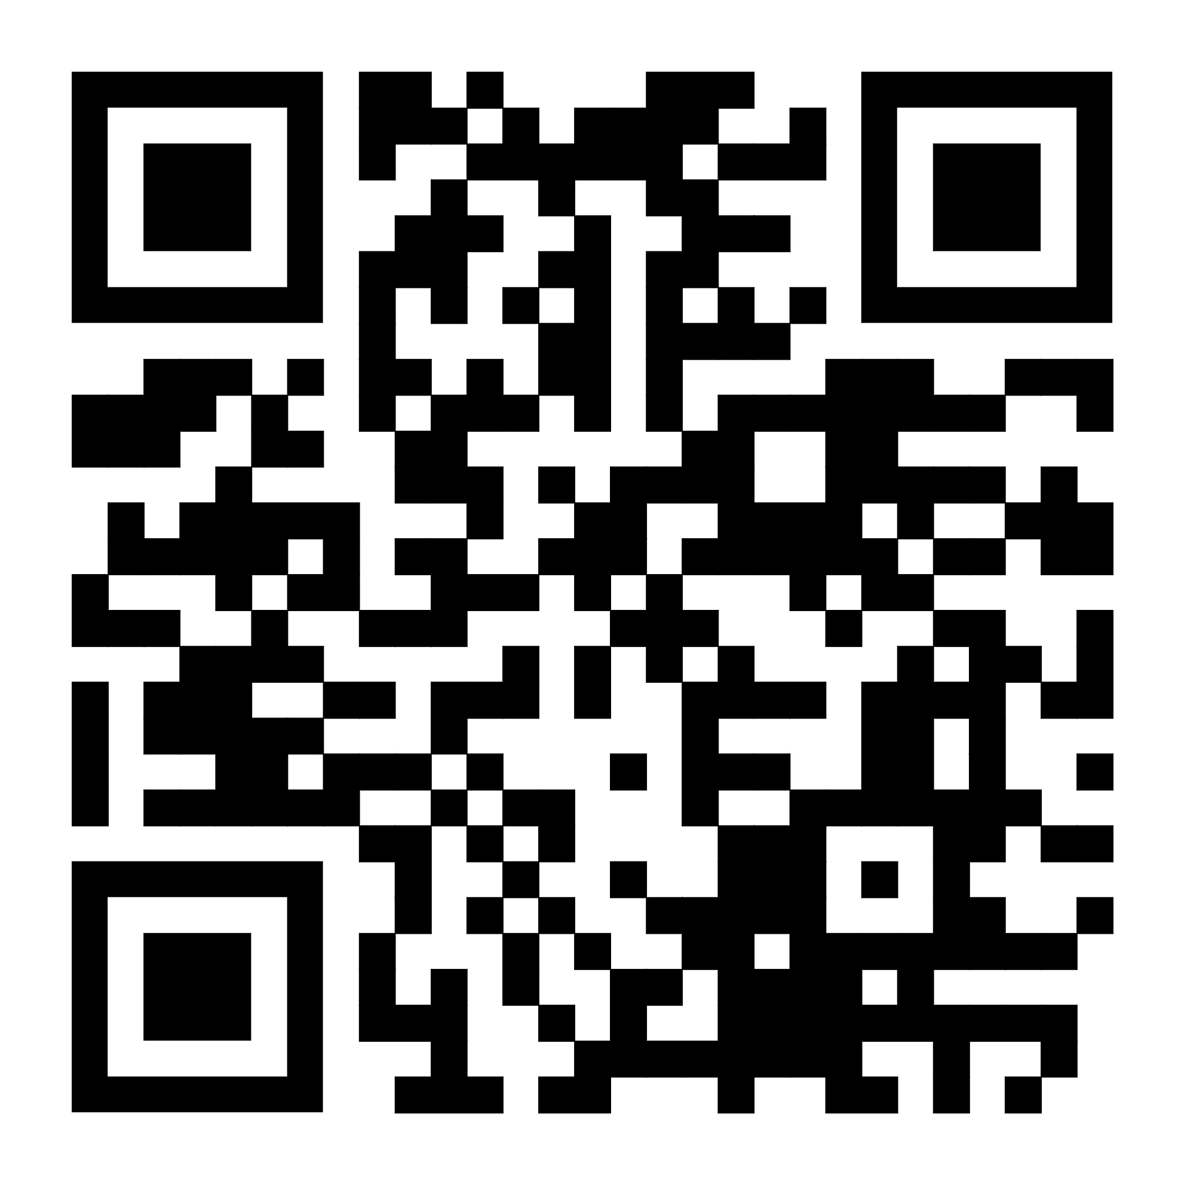
Team 205: Robotic Arm to Assist Motorized Chair Users
Sponsor: Mr. Keith Van Houten, PPMD
Team Members: Brooke Harrington, Justin Lee, Cavan Moriarty, Omar Abuljobain, Andrew Baum
Faculty Advisors: Mr. Stephen Moyer, Mr. Jim Hess
Background
Waterproofing
Waveshare Ro-Arm
Control Panel
Team Testing
Duchenne muscular dystrophy (DMD) is a progressive disorder that deteriorates muscles over time.
Users with DMD often require the use of motorized wheelchairs (Permobil M3)
People with DMD have limited range of motion (ROM) and often require a caretaker or robotic device to help with everyday tasks
Test | Results / Outcome
End Effector Load Capacity | 0.5 kg at max distance 0.6 kg at min distance
Verification of Safety Measures | Stayed within designated 300° of rotation
Joystick-Robot Accuracy | X Failed team standards Met ADA standards
Installation Time | 58.52 sec
Maintenance Time | 22 min 5 sec
Problem Statement
1 joystick (3 axis, 2 buttons)
2 switches for system & joystick enable
5 buttons for stored functions/location
Current assistive devices are too expensive, cover a large footprint, and are difficult for people with DMD to control.
People with DMD would benefit from a simple to control, affordable robotic aid that executes specific high value functions.
End-effector cover protects wrist servo
Sleeve protects elbow and base servo
Well protects internal electronics
End User Testing
Mounting
Customer Needs
Protoboard
Mounting Assembly Features:
Locking pin
Vertical and horizontal adjustment
Easy tightening
French cleat system
End User Comments:
Move the joystick closer to the edge to be in line with the armrest
Joystick with twisting motion may not be ideal for people with DMD
End-effector tip requires non-slip material for button pressing
Armrest attachment for additional support
Safety – Robot doesn’t hit user or other people | System withstands rainfall whilst maintaining normal operation
Ease of assembly, installation, and maintenance | Easily portable and self-contained for travel
Intuitive Controls that are like controls found on the wheelchair | Attached system fits through ADA compliant doorframe
Affordability (current market solutions >$60,000) | Ability to save custom, frequently-visited locations using buttons
Team 205 meeting with Colin Werth for testing
Conclusions
Complete Two High Value Functions
Completes high value functions and meets user requirements
Affordable at < $2,000
Compatible mounting with Permobil wheelchair
Open source – GitHub
Push an ADA compliant elevator button
Colin testing:
Mounting position
User interface
Retrieving a drink
Ergonomics
Fitting through an ADA compliant door
Team testing:
Accuracy of robot to hit elevator button
End effector slipping
Visibility, ease of maneuverability
Retrieve and return a drink to and from the user from a user programmed location
Images
GitHub Information
Code
CAD Files
Tutorials
For others to reproduce our project and expand upon our work
GitHub
Recommendations &
What we’d do differently
Possible better robot arm choices – more research
Refined case design
Reworked electronics: different microcontroller and printable circuit board instead of protoboard
Special
Thanks!
The Werth Family and the Team at PPMD
Mr. Jim Hess,
Mr. Stephen Moyer,
Mr. Rick and Ms. Kristie from QL+

